Slide 1
Paziente con fibrillazione atriale e scompenso cardiaco
Dr. Martino Pepe
Cardiologia Universitaria
Policlinico di Bari

Slide 2
In HF patients AF prevalence ranges from 12 to 50%
Prevalence of AF increases with HF worsening
Notes:
EORP-AF: 9 european countries
47.5% HF
4% LV dysf to 50% NYHA 4

Slide 3
Loh et al, NEJM 1997
Notes:
Pts from SAVE trial: MI + FE < 40%
Early stroke connected to early occurrence of atrial arrhythmias

Slide 4
Heart failure and thromboembolic risk
Hypotheses:
deceleration of peripheral and intracardiac blood flow due to peripheral congestion and impaired cardiac contractility
endothelial dysfunction (impaired NO response)
prolonged bed rest in severely ill cases
the presence of coagulation defects as, for example, in the case of ventricular assist devices

Slide 6
VKA limitations
Intra- and interpatient variability in dose response
susceptibility to drug–drug and drug–food interactions
narrow therapeutic index necessitate periodic monitoring of physiologic response to warfarin using the international normalized ratio (INR)

Slide 7
HF and VKA: the bleeding risk
Witt et al, J Thromb Haemost 2010
Notes:
Different indications fro VKA
At least one INR every 8w
Stable group: all INR ok for 12m

Slide 8
Predictors of TTR<55%
Nelson et al, 2013 AmJCardiol
Notes:
>23000 pts

Slide 9
HF and VKA: the bleeding risk
>4000 pts from the AFFIRM study
Di Marco et al, Am Heart J 2005
Notes:
FU 3.5y

Slide 10
In summary Disadvantages of HF patients in therapy with VKA
Multiple drugs
More frequent hepatic
and renal dysfunction
Greater INR lability

Slide 11
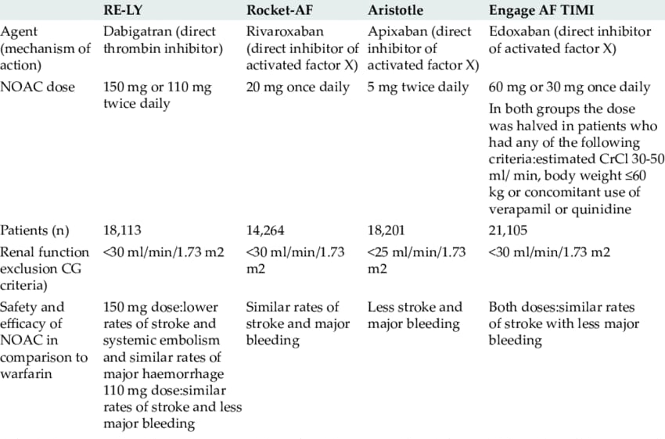
What about DOACs?

Slide 12
DOAC’s registration trials: HF subpopulations
Zeitler et al, JAFIB 2015

Slide 14
ROCKET AF-HF: impact of HF
Rivaroxaban vs VKA
9033 pts with HF history or LVEF<40%
Mean CHADS₂ Score 3.5
Van Diepen, Circ Heart Fail. 2013

Slide 15
ROCKET AF-HF: outcomes by HF and therapy
P=0.62 for interaction
Van Diepen, Circ Heart Fail. 2013

Slide 16
ROCKET AF-HF: outcomes by HF and therapy
Van Diepen, Circ Heart Fail. 2013

Slide 17
RE-LY: HF subgroup analysis
Definition: NYHA > 2 in the last 6 mo + history of HF
P 0.012
P 0.02
Ferreira et al, Eur J Heart Fail 2013
Notes:
Heart failure was defined as the presence of NYHA class II or higher HF symptoms (fatigue, dyspnoea) in the 6 months before screening, in patients with a history of previous admission for congestive HF
To explain lack of difference in thromboembolic risk: Hypertension, previous stroke, age

Slide 18
RE-LY HF: outcomes
ns
ns
Ferreira et al, Eur J Heart Fail 2013
Notes:
RELY: equal bleeding

Slide 19
RE-LY HF: outcomes
ns
ns
Ferreira et al, Eur J Heart Fail 2013
Notes:
RELY: equal bleeding

Slide 20
ARISTOTELE subanalysis
14.671 pts
3207 patients
Symptomatic HF and an EF >40%
(study definition of HF-PEF)
2736 patients
EF ≤40%
(moderate or severe LV dysfunction)
8728 patients
no symptomatic HF and an EF >40%
McMurray et al, Circ Heart Fail 2013

Slide 21
ARISTOTELE subanalysis
Composite primary outcome: stroke + SE
ns
McMurray et al, Circ Heart Fail 2013
Notes:
Numerically higher for blu and red

Slide 22
Treatment effect by HF/LVSD: efficacy and safety endpoints
“Apixaban was superior to warfarin with respect to both efficacy and safety outcomes in all patient groups, with the greatest absolute benefit in the highest risk patients with LVSD”.
McMurray et al, Circ Heart Fail 2013
Notes:
ARISTOTELE: apixaban superior to w for both stroke/SE and safety

Slide 23
ENGAGE AF-HF: outcomes by HF degree
HDER only!
Previous history or presence of HF stage C/D (ACC/AHA definition)
Magnani et al, European Journal of Heart Failure 2016
Notes:
Definition: previous history or presence of HF stage C/D accordinig to ACC/AHA definition
Also major bleeding for both NYHA II/III vs NO and NYHA III/VI vs NO

Slide 24
ENGAGE AF-HF: outcomes by HF and therapy
All p<0.05
Magnani et al, European Journal of Heart Failure 2016
Notes:
* P significant for non inferiority

Slide 25
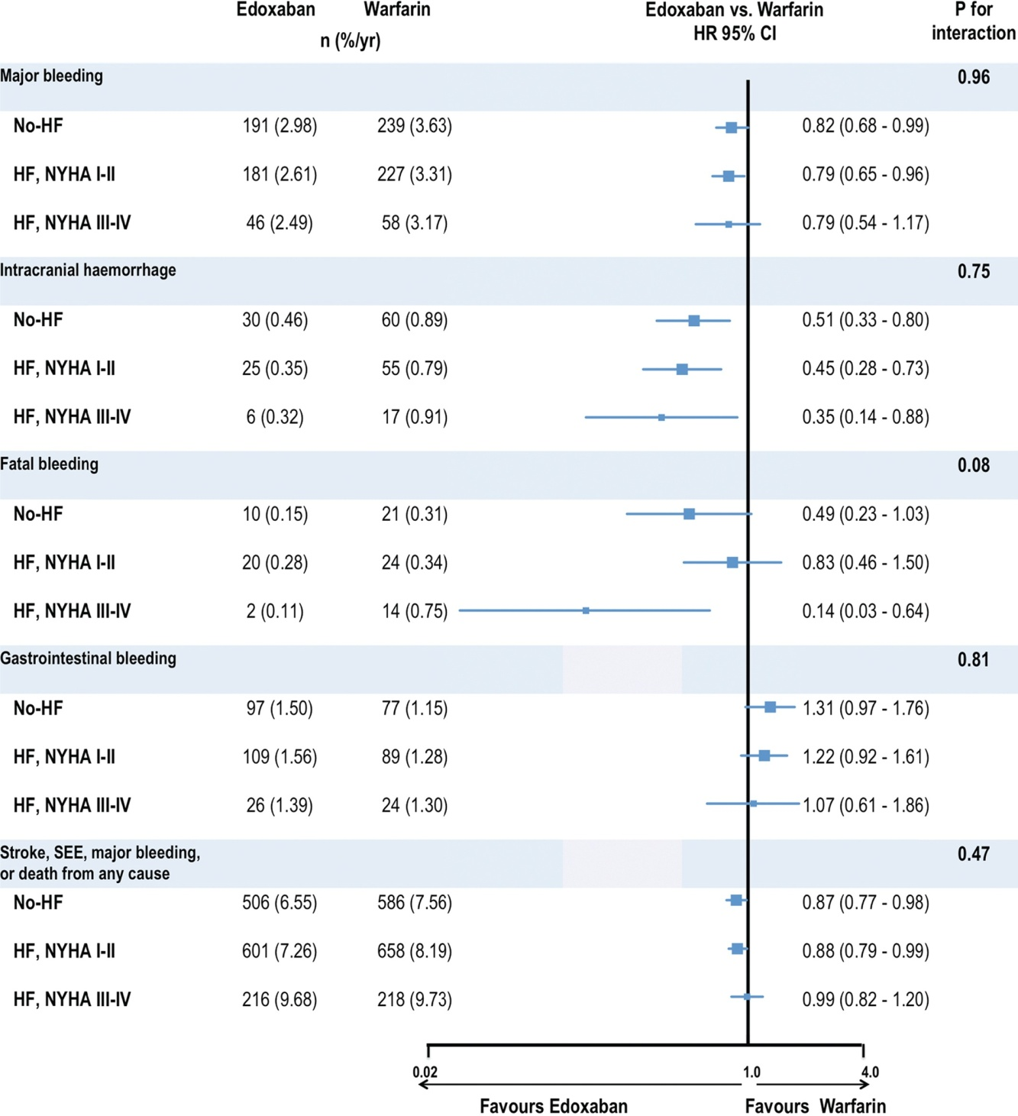
ENGAGE AF-HF: outcomes by HF and therapy
p p 0.04
p p 0.02
All p<0.05
Magnani et al,
European Journal of Heart Failure 2016

Slide 26
Overall results
Zeitler et al, JAFIB 2015

Slide 27
AF +HF metanalysis
RCT: RE-LY, ARISTOTELE, ROCKET-AF, ENGAGE-AF
Primary efficacy outcome: stroke/SE
19122 NAO vs 13390 VKA
OR 0.86
p 0.02
Xiong et al, European Journal of Heart Failure 2015

Slide 28
AF +HF metanalysis: SAFETY
OR 0.76
p <0.00
Xiong et al, European Journal of Heart Failure 2015
Notes:
NO Rivaroxaban (Diepen)

Slide 29
AF +HF metanalysis: SAFETY
OR 0.43
p <0.00
Xiong et al, European Journal of Heart Failure 2015
Notes:
No Edoxaban (Giugliano)

Slide 30
Heart failure and sinus rhythm?
Rationale:
deceleration of peripheral and intracardiac blood flow due to peripheral congestion and impaired cardiac contractility
prolonged bed rest in severely ill cases
endothelial dysfunction (impaired NO response)
the presence of coagulation defects as, for example, in the case of ventricular assist devices
increased risk for misdiagnosed atrial fibrillation

Slide 31
Warfarin has failed to demonstrate improved outcomes in pts with HF and SR
ASA
ASA
ASA
Notes:
Increased bleeding risk!!

Slide 32
COMMANDER HF
Zannad NEJM 2018

Slide 33
Rationale for the Commander HF design
Korjian et al, AJCC2018
Branch et al, Circulation 2019
Notes:
Efficacy endpoint: CV death/ MI/ stroke.

Slide 34
COMMANDER HF
Zannad NEJM 2018

Slide 35
COMMANDER HF: safety outcomes
In patients with recent worsening of chronic HF and reduced ejection fraction who also have underlying CAD and are not in AF, low-dose rivaroxaban, when added to guideline-based therapy, does not improve the composite of all-cause mortality, MI, or stroke, nor does it favorably influence HF rehospitalization

Slide 36
Take home messages
Thromboembolic risk increases with the worsening of HF
In patients with both NVAF and HF all DOACs demonstrated the same efficacy/safety profile showed in the overall populations
To date in patients with HF without AF the anticoagulation therapy did not prove benefit in prevention of ischemic events and death

Slide 37
Grazie per l’attenzione

